Slide 1
Question Answering Systems
Speaker: 呂瑞麟
國立中興大學資管系教授
Email: jllu@nchu.edu.tw
URL: http://web.nchu.edu.tw/~jlu

Slide 2
What is Question Answering?
目前所知，QA 大致分成兩類

Slide 3
Question Answering: Example
Suppose you have a series of statements:
Joe went to the kitchen. Fred went to the kitchen. Joe picked up the milk. Joe travelled to the office. Joe left the milk. Joe went to the bathroom.
And you have been asked the below question:
Where was Joe before the office?
The appropriate answer would be “kitchen”
ex. SQuAD
Source: https://www.analyticsvidhya.com/blog/2018/03/essentials-of-deep-learning-sequence-to-sequence-modelling-with-attention-part-i/

Slide 4
Question Answering: Example
The famous TV game-show Jeopardy!
From which university did the wife of Barack Obama graduate?
How many universities are located in Taichung?
這一類的 QA 假設有一個“知識庫”
Linked Data 扮演著 “知識庫”的角色
DBpedia 是一個著名的 Linked Data
以 RDF 儲存

Slide 5
QALD
QALD 就是把使用者輸入的自然語言（語音或者文字；目前最終都是轉成文字）轉成 RDF 的查詢語言（ex. SPARQL）
Natural Language → ?? → SPARQL
It is a HARD problem
嚴格來說，QALD is a benchmarking campaign since 2010.

Slide 6
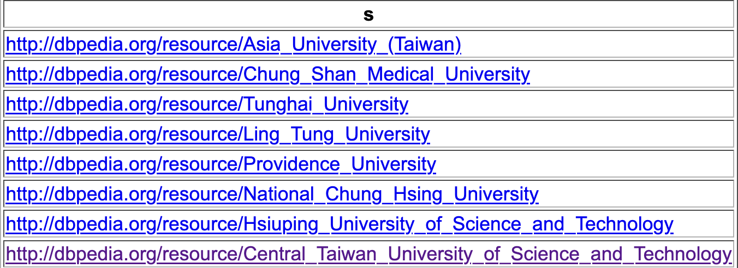
An Example
Which universities are located in Taichung?
SPARQL：
select ?s where {
?s rdf:type dbo:University.
?s dbo:city dbr:Taichung.
}

Slide 7
What to be covered?
Language Models
y is a label: text categorization (ex. sentiment analysis)
y is a sequence: POS tags
POS Tagging
Dependency Tree
Deep Learning for Sequence Data
Embeddings
Sequence to Sequence (with Attention)
Transformers

Slide 8
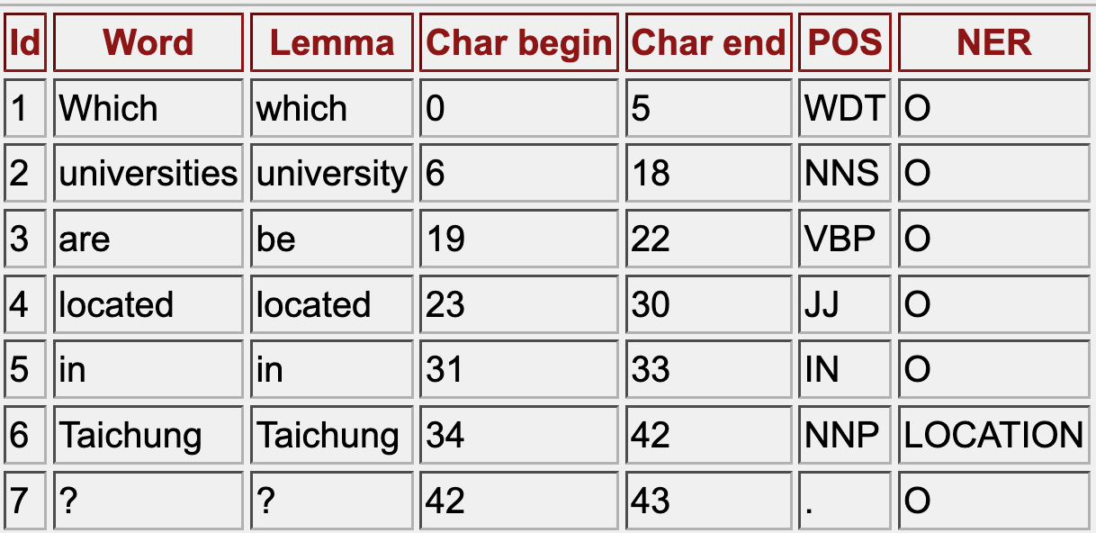
自然語言處理工具
* POS Tagging 詞性標記：我們之後再說

Slide 9
Dependency Tree

